Slide 1

Hiring Process Analytics
Presentation by Abhishek Adyani

Slide 2
Project description
What is Hiring Process?
What will I be doing?
Insights
The hiring process is a crucial function of any company, and understanding trends such as the number of rejections, interviews, job types, and vacancies can provide valuable insights for the hiring department
As a data analyst, I'll be given a dataset containing records of previous hires. My job is to analyze this data and answer certain questions that can help the company improve its hiring process.
Exploring and understanding hiring funnel data are key components of hiring analytics, providing actionable insights for streamlining the recruitment process.

Slide 3

Tech-Stack Used
Microsoft Office Excel 2021
I used this software as it has various functions that are convenient and faster to use. It helps in drawing meaningful conclusions about the company’s hiring process faster.

Slide 4
FINDINGS: A) Hiring Analysis: Determine the gender distribution of hires. How many males and females have been hired by the company?
With the help of PIVOT TABLE I found out there are 2563 male employees that are hired & 1856 female employees that are hired.
Alternatively we can also use COUNTIFS formula to determine the count of male and female employees hired.

Slide 5
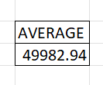
B) Salary Analysis: What is the average salary offered by this company? Use Excel functions to calculate this.
By using the inbuilt function of formula AVERAGE, I calculated the average salary offered by the company i.e 49982.94

Slide 6
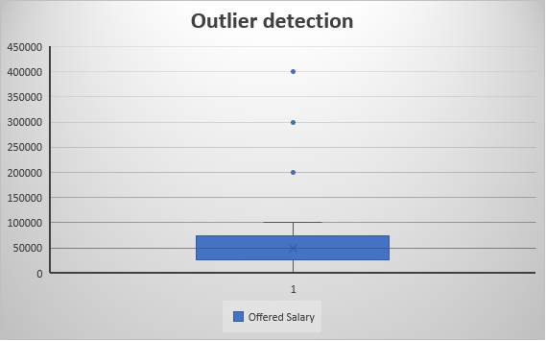
C) Salary Distribution: Create class intervals for the salaries in the company. This will help you understand the salary distribution.
Firstly check for the outlier and remove if necessary. I removed the outliers using the box-plot chart.
There were three outliers to be removed, after that I split the data into class intervals

Slide 8
D) Departmental Analysis: Use a pie chart, bar graph, or any other suitable visualization to show the proportion of people working in different departments.
Department | no. of employees
Finance Department | 176
General Management | 113
Human Resource Department | 70
Marketing Department | 202
Operations Department | 1843
Production Department | 246
Purchase Department | 230
Sales Department | 485
Service Department | 1332
With the help of pivot table I first filtered count all the employees working in their respective domain, after then I visualize that data in a pie chart for better understanding the proportion of people working in different departments.

Slide 10
E) Position Tier Analysis: Use a chart or graph to represent the different position tiers within the company. .
Post Name | no. of people hired
b9 | 308
c-10 | 105
c5 | 1182
c8 | 193
c9 | 1240
i1 | 151
i4 | 32
i5 | 511
i6 | 337
i7 | 635
m6 | 2
n6 | 1
With the help of pivot table I first filtered post names and count of all the employees in the different post tiers, after then I visualize that data in a column chart for better understanding the position tier.

Slide 12

Insights
There are a total of 2563 male employees and 1856 female employees that are hired.
The average salary offered by the company is 49982.94.
From the column chart of salary range for hired and rejected we found that the highest is 414 in the salary range of 40,000-49,999. And for the hired only chart we find that maximum number i.e. 279 works in the salary range of 40,000-49,000.
Major proportion of the employees work in operations department (39%) and service department (28%), highest being 1843 and after that 1332 respectively.
Most of the people hired are for the post C-9 of the company i.e. 1240.

Slide 13

Result
This project helped me understand how the hiring process works and types of questions I have to tackle to bring out the best insight for the company, for them to make the best data driven decisions. I used my knowledge of excel and various functions like average, count, pivot table etc. as well as various types of charts to visualize the insights.

